Slide 1
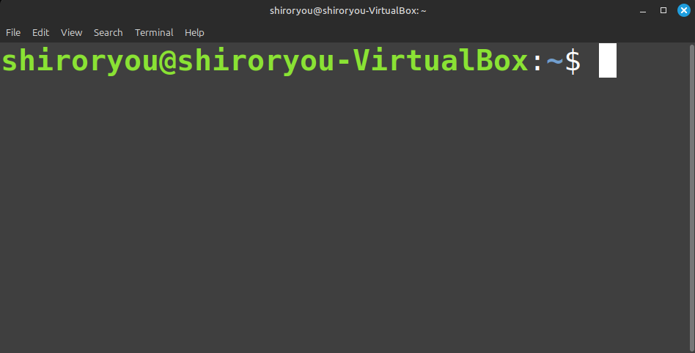
HOSTNAME – the machine name/ the name assigned to your computer
USERNAME
This is a shorthand for home directory (/home/username)
Just a separator, indicates the Username at Hostname
$ sign is a symbol which indicates that you are logged in as a normal user
You remember the # sign when we logged in as the super user? (when you used sudo su in the beginning)
Another Separator, indicates the separation of the username@hostname from the path

Slide 2
command [option(s)] [argument(s)]
The main action or program you want to execute
Modify the behavior of the command (often starts with `-` or `--`)
The target on which the command operates (like files, directories, users, etc.)
cp file.txt /home/user/
Command: cp copy files
Arguments:
file.txt - the source file to copy
/home/user/ - the destination directory
Operation: the file, file.txt is copied to the /home/user/ directory.
sudo -su
Command: sudo - run a command as superuser/root
Arguments:
-s - start a shell
u - switch to a specified user, default is root
Operation: starts a shell as the specified user.
find /home -name "*.txt"
Command: find (search for files)
Arguments:
/home - the directory to search in
-name "*.txt" - search for files ending with .txt
Operation: Looks for all .txt files in the /home directory.

Slide 3
'sudo' allows admin to temporarily gain root privileges.
The admin installs the Apache web server, available for all users.
'apt-get' is a package manager used in Debian-based systems to install software.
Admin installs an essential web server for company-wide use.
Without admin privileges, a normal user couldn’t install the server for everyone.
Root edits the SSH configuration file, which controls secure shell access.
The root user needs to change SSH settings to secure remote logins.
Only root has permission to modify this critical file.
Only root can modify system-wide files like /etc/ssh/sshd_config
Task: Install software for all users
$ sudo apt-get install apache2
Explanation:
Real-world Scenario:
read (r)
write (w)
execute (x)
ls –l
-rw-r--r-- 1 shiroryou users 1024 Sep 20 myfile.txt
shiroryou can read and write, others can only read.
Can install/uninstall software
Can manage users (create/delete/change permissions)
Can access some system files, but not all root-level files
Example:
Can modify/delete any file (including critical system files)
Can create and delete users
Can change any user’s permissions
Has access to all system configurations and files
Task: Modify system-wide configuration file
# nano /etc/ssh/sshd_config
Explanation:
Real-world Scenario:
Permissions:
Example:
Elevated Privileges
Full Control Over System:
Example:
Normal User (shiroryou)
Admin User (admin)
Root User (root)

Slide 4
d: Indicates file type (directory).
rwxr-xr-x: File permissions:
Number of hard links pointing to this directory.
shiroryou: Owner of the directory.
shiroryou: Group associated with the directory.
4096: Size of the directory in bytes (standard size for directories).
Sep 11 13:53: Last modification date and time (September 11, 13:53).
Downloads: Name of the directory.
r-x (Others): Read and execute permissions for others.
r-x (Group): Read and execute permissions for group (shiroryou); no write.
rwx (Owner): Read, write, and execute permissions for owner (shiroryou).
-: Indicates file type (regular file).
rw-rw-r--: File permissions:
Number of hard links pointing to this directory.
shiroryou: Owner of the directory.
shiroryou: Group associated with the directory.
0: Size of the file in bytes (empty file).
Sep 22 13:18: Last modification date and time (September 22, 13:18).
file1.txt: Name of the file.
r-- (Others): Read-only permission for others..
rw- (Group): Read and write permissions for group (shiroryou); no execute.
rw- (Owner): Read and write permissions for owner (shiroryou); no execute.)

Slide 5
File Type
- (Regular File)
d (Directory)
l (Symbolic Link)
b (Block Device)
Permissions (Owner, Group, Others)
r: Read
w: Write
x: Execute
-: No permission
Link Count (Number of Hard Links)
1 (Regular File)
2+ (Directory or Linked Files)
Owner (Username)
shiroryou (Example owner)
root (System Files Owner)
Group (Group Name)
shiroryou (User Group)
www-data (Example Group for Web Directories)
File Size (Bytes)
0 (Empty File)
4096 (Directory Metadata Size)
Any Size in Bytes (For Larger Files)
Modification Date & Time
Format: MMM DD HH:MM
Recent Files: Shows Time
Older Files: Shows Year
File/Directory Name
Regular File: file1.txt
Directory: Downloads
Hidden Files: .bashrc (Starts with .)

Slide 6
Core components of a Linux-based OS (and boot process )
Bootloader
The first program that runs when the system is powered on.
Example: GRUB (Grand Unified Bootloader).
Loads the kernel into memory and hands over control.
Kernel
The core of the Linux operating system.
Manages hardware resources and enables communication between hardware and software.
Performs essential tasks like memory management and process scheduling.
Ubuntu
Fedora
Debian
Init System
The first process started by the kernel.
Responsible for initializing system services and managing system processes.
Example: systemd.
Linux Distribution Structure
Linux Distribution
Flavors (Variants of Distributions)
Desktop Environment (DE)
Applications
Includes essential tools like file managers, web browsers, and more.
GNOME (Default)
Kubuntu (KDE)
Fedora GNOME (Default)
Fedora KDE
Debian GNOME
Debian Xfce
A complete operating system built on the Linux kernel.
Combines the kernel, system utilities, libraries, and software packages.
Examples:
Variety of desktop environments or specialized configurations.
Examples of flavors for each distribution:
The graphical interface that provides the user experience.
Manages windows, panels, icons, and overall look and feel.
Examples of DEs for each flavor:
End-user programs that run within the desktop environment.
Examples:
Daemons
Background services that start during the boot process or after login.
Examples: Network services, print services, etc.
Ubuntu Flavors:
Fedora Flavors:
Debian Flavors:
Graphical Server
Responsible for displaying graphical interfaces.
Example: X Server or Wayland.
Manages user input (keyboard, mouse) and screen output.
GNOME
Desktop Environment
Provides the user interface and manages user interaction with the system.
Examples: GNOME, KDE.
Includes window managers, panels, menus, etc.
KDE
Xfce
Applications
End-user programs that run within the desktop environment.
Examples: Web browsers, file managers, etc.
Provide functionality and tools for daily tasks.
Web Browsers
File Managers

